Slide 1
ASSISTIVE TECHNOLOGY: MEETING THE NEEDS OF ALL
Robbie Hampton, Ed.D.

Slide 2
Who’s in the Room

Slide 3
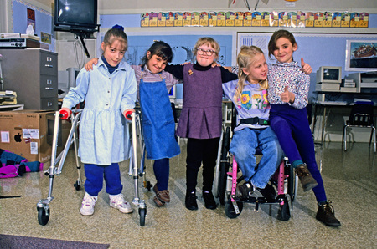
What are the stumbling blocks to serving children with special needs in the general education setting?

Slide 4
What is Assistive Technology?

Slide 5
Definition
IDEA defines an 'assistive technology device' as... any item, piece of equipment, or product system, whether acquired commercially off the shelf, modified, or customized, that is used to increase, maintain, or improve functional capabilities of a child with a disability.

Slide 6
Who Benefits
Students with:
Vision and hearing impairments
Sensory disorders
Behavioral challenges
Orthopedic disorders
Intellectual and learning disabilities
Speech/language impairments
Traumatic Brain Injury
Typical Children

Slide 7
UDL
Universal Design for Learning (UDL) is a set of principles for designing curriculum that provides all individuals, including those with learning differences, with equal opportunities to learn.
UDL principles call for varied and flexible ways to:
Present or access information, concepts, and ideas (the "what" of learning)
Plan and execute learning tasks (the "how" of learning)
Get engaged - and stay engaged - in learning
UDL and Assistive Technology-Building accessibility into new technologies and curricular materials as they are developed will help to ensure the maximal inclusion of children with disabilities into the full array of learning opportunities that are available to all children.
http://www.wrightslaw.com/info/atech.index.htm
Notes:
Many products (devices, software, curriculum) are being designed today that are meant for general use but address the needs of individuals with disabilities
UDL and AT helps to lower cost of materials/devices because it increases the number of individuals

Slide 8
AT Applications
Aids to Daily Living (ADL)
Electronic Aids to Daily Living (EADL)
Alternative Computer Access
Augmentative and Alternative Communication (AAC)
Architectural Modifications
Positioning and Mobility
Transportation
Sensory Technology

Slide 9
Low-tech vs high-tech
Low-tech
High-tech
Non-electronic
Easy to transport
Reliability
Electronic
Expandability

Slide 10
AUGMENTATIVE AND ALTERNATIVE COMMUNICATION (AAC)

Slide 11
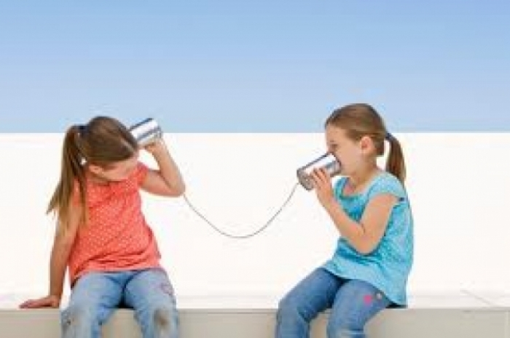
Receptive Communication
Conversation
Social skills
Classroom instruction and directions
Cues

Slide 12
Expressive Communication
Conversation
Requests
Participation in classroom instruction
Initiation

Slide 13
Written Communication
Texting
Note taking
Classroom assignments

Slide 14
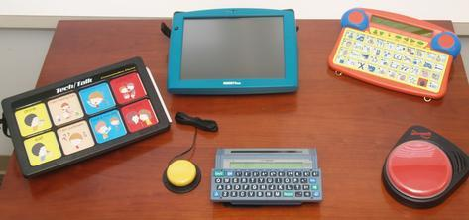
AAC Tools
Speech Generating Devices (SGD)
Tablets/iPads
Manual communication books and boards
Eye gaze systems

Slide 15
ALTERNATIVE COMPUTER ACCESS

Slide 16
Device Access
Mouse alternatives
Switch-single button, scanning
trackball
Keyboard (software settings, alternative keyboards)
Eye gaze
Voice command and output
Work station alternatives-positioning of device
Alternative monitors
Screen readers
Notes:
Determine what needs to be done
Choose apps/software
Choose device

Slide 17
Computer Applications
Built-in software accessibility settings
Dedicated software
Apps
Communication-email, social networking

Slide 18
SEATING, POSITIONING AND MOBILITY

Slide 19
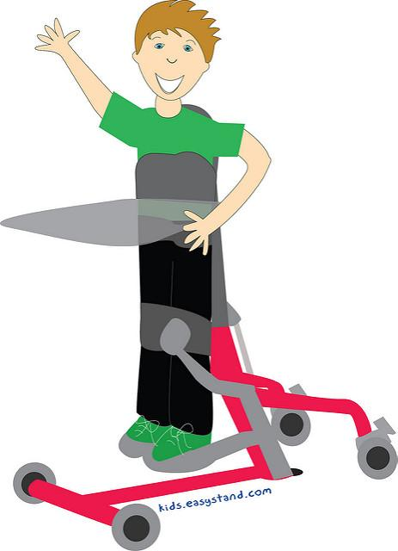
Seating/Positioning
Behavior intervention
Allows student to be part of group
Facilitates participation in instruction
Increases independence
Notes:
Working with OT/PT to address seating concerns

Slide 20
Mobility
Ambulatory and wheeled
Allows for transitioning to all areas of building
Increases independence

Slide 21
RESOURCES

Slide 22
Websites
American Printing House for the Blind
http://www.aph.org/
Harris-Hillman Technology Lab
http://harris-hillmantechlab.weebly.com/
Technology Access Center
http://tacnashville.org/

Slide 23
Assistive Technology Survey

Slide 24
Dr. Robbie Hampton
Robbie.Hampton@lipscomb.edu
615-966-6171

