Slide 1
SEAMLESS Alignment And integrated learning support
Rethinking Remediation, Creating a Pathway to Postsecondary Success
September 13, 2017

Slide 2
Remediation: Bridge to Nowhere
Complete College America, April 2012
National Remediation Needs
Entering 2 Year Institution | Entering 4 Year Institution
51.7% | 19.9%
Tennessee Remediation Needs for Community Colleges (2011)
Any Remediation | Math Remediation
76.8% | 71%
Of students that start in remediation,
less than 5% graduate in 3 years!

Slide 3
SAILS: Rethinking Remediation
SAILS is accepted at all 13 TN Board of Regents community colleges to satisfy all remediation needs in math and English.

Slide 4
What SAILS Is
K-12 and Higher Education Partnership
Developed to by Red Bank High School teacher and faculty at Chattanooga State.
Competency Based
Students only progress in the course when they have mastered the material
Blended Learning Environment
Students work online, with peers or licensed K-12 math teacher
Field Coordinators
Serve as liaisons between the K-12 teachers and community colleges to provide continuous support.

Slide 5
What SAILS is Not
ACT prep course
Students are not required to retake the ACT for placement in credit bearing courses.
Means of obtaining college credit
SAILS exempts students from remediation but is not transcripted as credit.
Extra Financial Burden Students
SAILS is funded directly by the General Assembly at no cost to students are schools.

Slide 6
SAILS Operations
Advisory Board
TBR, UT, TDOE, THEC, Chattanooga State, Northeast State,
Shelby County Schools, TN College Access & Success Network,
and Office of Governor Haslam
Tennessee Higher Education Commission
Program Director: Victoria Harpool
Chattanooga State Community College
SAILS Director: Jeannette Tippett
West TN Director
8 Field Coordinators
Middle TN Director
10 Field Coordinators
East TN Director
10 Field Coordinators

Slide 7
SAILS Math Content
Module 1: Real Numbers (MLS1)
Module 2: Operations with Algebraic Expressions (MLS2)
Module 3: Equations and Inequalities (MLS4)
Module 4: Linear Graphing (MLS3)
Modules 5: Advanced Topics (MLS5)
Built on K-12 Bridge Math course and TBR Learning Support Competencies.

Slide 8
SAILS English Content
Module 1: Anglo-Saxon Literature and Introduction of College Reading and Writing
Module 2: Medieval Literature and vocabulary building
Module 3: Renaissance Literature with sonnet analysis
Module 4: Romantic &Victorian Literature
Modules 5: World War I Literature
Built on K-12 English IV and TBR learning support competencies.

Slide 9
SAILS 2016-17
SAILS Math
92 of 95 counties
280 High Schools, over 13,000 students
13 Community Colleges
SAILS English
2 counties
18 High Schools, nearly 350 students
Chattanooga State and Roane State Community Colleges
SAILS reaches nearly half of the students that test not college ready in math at the end of their junior year.

Slide 10
SAILS Success

Slide 11
SAILS Success
SAILS Math
Year | High Schools | Colleges | Enrolled | Complete
Spring 2012 | 1 | 1 | 20 | 80%
2012-13 | 20 | 4 | 500 | 82%
2013-14 | 118 | 13 | 8,186 | 69%
2014-15 | 179 | 13 | 10,907 | 91%
2015-16 | 243 | 13 | 14,148 | 92%
2016-17 | 276 | 13 | 13,113 | 97%
SAILS English
Year | High Schools | Colleges | Enrolled | Complete
2015-16 | 5 | 1 | 104 | 98%
2016-17 | 18 | 2 | 346 | 95%

Slide 12
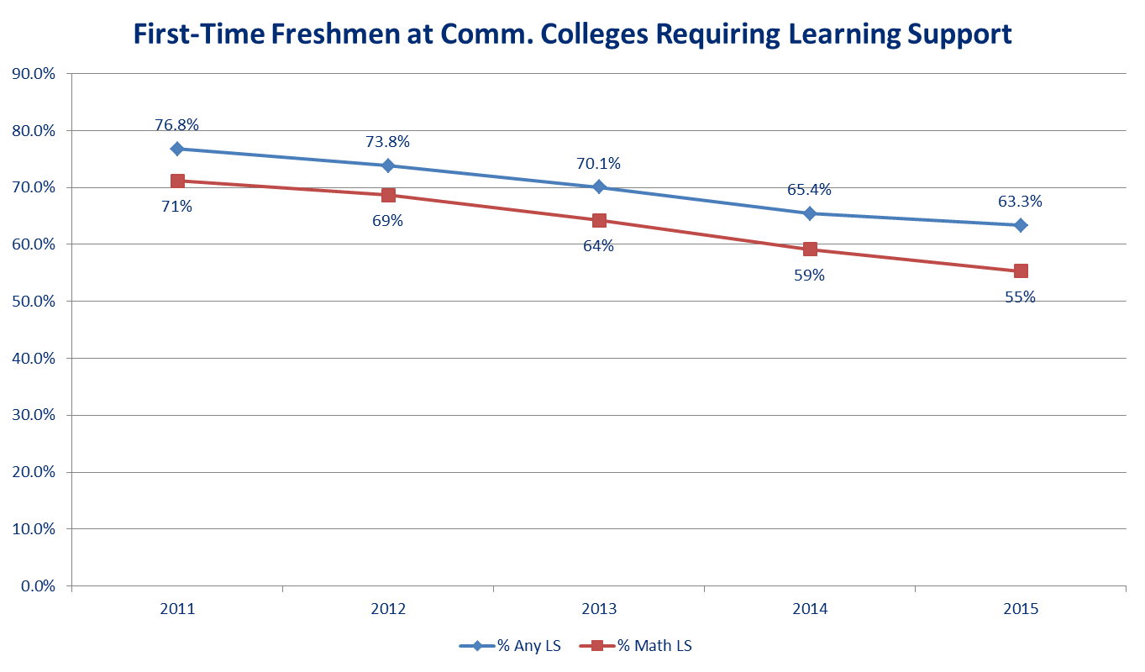
Affects on Remediation Rates

Slide 13
SAILS+
College level curriculum designed by team of college faculty and SAILS math experts.
Designed for students that complete SAILS math early
Allows students to be placed into college algebra
Piloted in 2016-17 and now available around the state

Slide 14
SAILS+ Content
SAILS+ Module A: Systems of Equations
SAILS+ Module B: Exponents and Factoring Trinomials
SAILS+ Module C: Operations and Equations with Rational Expressions
SAILS+ Module D: Operations and Equations with Radicals
SAILS+ Module E: Quadratic Equations, Polynomial Inequalities, Piecewise Functions
Each module consists of assignments and a module quiz.
The SAILS+ content culminates in a comprehensive final exam.

Slide 15
SAILS Research

Slide 16
Computer-Mediated Developmental Math
Community College Research Center, Teachers College, Columbia University, Maggie P. Fay, February 2017
Explores the institutional context of high schools compared with colleges in the ways that may affect the implementation and efficacy of computer-mediated mathematics
2015 TN has almost identical online courses were offered to community colleges students and SAILS high school students (prior to implementation of co-requisite model)
Site visits and data collected from 3 community colleges and 4 SAILS high schools

Slide 17
Computer-Mediated Developmental Math
Research suggests “non-cognitive” or “non-academic” skills play a critical role in student achievement.
Includes behaviors that facilitate academic success, such as time-management, self-efficacy, motivational, and help-seeking behaviors.
Findings: High school students were much more likely to complete the course in 1 semester
High schools had structures and practices to foster students success under the premise that such students are unlikely to have autonomous, self-directed study habits.
Institutional Structures: Rigid daily academic schedules, enforced attendance requirements, requirement of completion, SAILS field coordinators
Practices: more short-term assignments, frequent feedback, reminders and monitoring to comply with deadlines, parental involvement

Slide 18
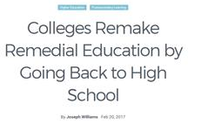
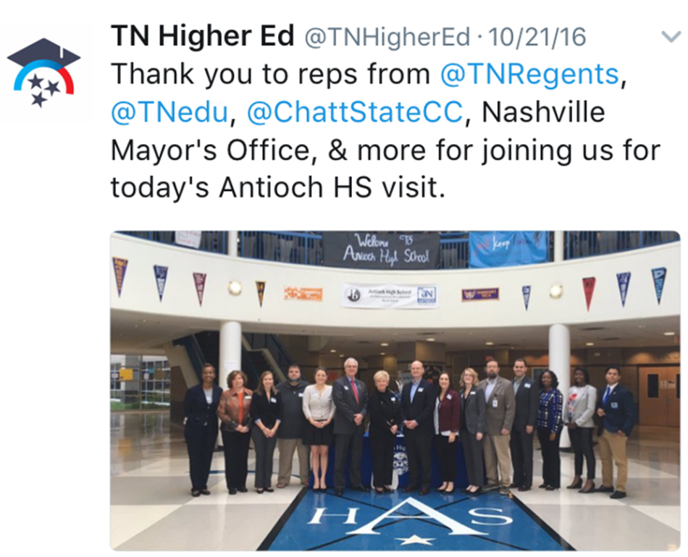
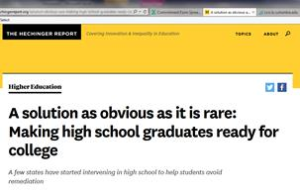
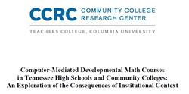
SAILS in the News

Slide 19
Victoria Harpool Tennessee Higher Education Commission Assistant Executive Director for Academic Affairs victoria.harpool@tn.gov
Questions
Jeannette Tippett Chattanooga State Community College SAILS Director
Jeannette.Tippett@ChattanoogaState.EDU

